Slide 1
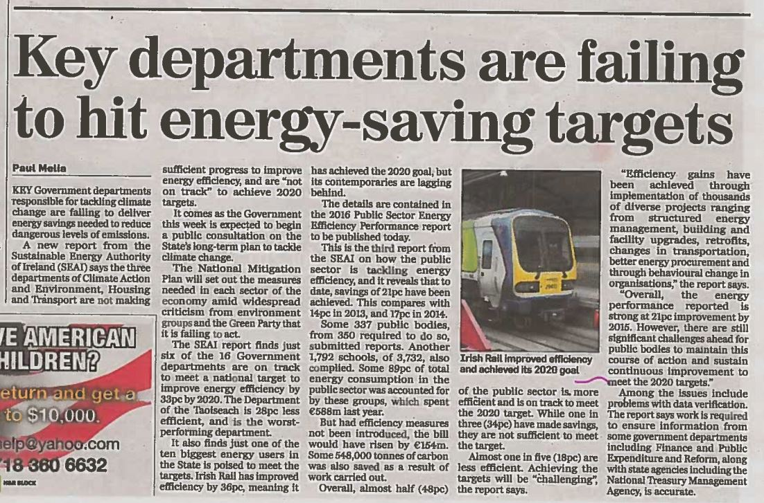
Why?
Source: The Independent, 12/12/16
Notes:
Or perhaps, you are simply concerned about image.
So when you see articles mentioning 6 Govt Departments – Does someone get it in the ear?
Source: http://www.independent.ie/irish-news/key-departments-are-failing-to-hit-energysaving-targets-35286079.html accessed 4/1/17

Slide 2
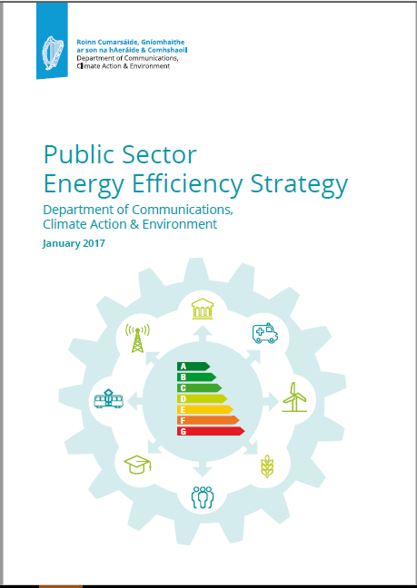
Public Sector Strategy
Led by Department of Communications, Climate Action and Environment
User level
  Energy Performance Officers (EPO) appointed in all 350 PBs
Steering groups
  SEAI, OPW, DPER, DCCAE, NTMA etc
  17 government EPOs (Assistant Secretary level)
Oversight of strategy delivery, specifically
  Energy management status
  M&R data and energy performance data
    Department and aegis body performance
    Individual public body performance
  Project pipeline
  Memo to government

Slide 3
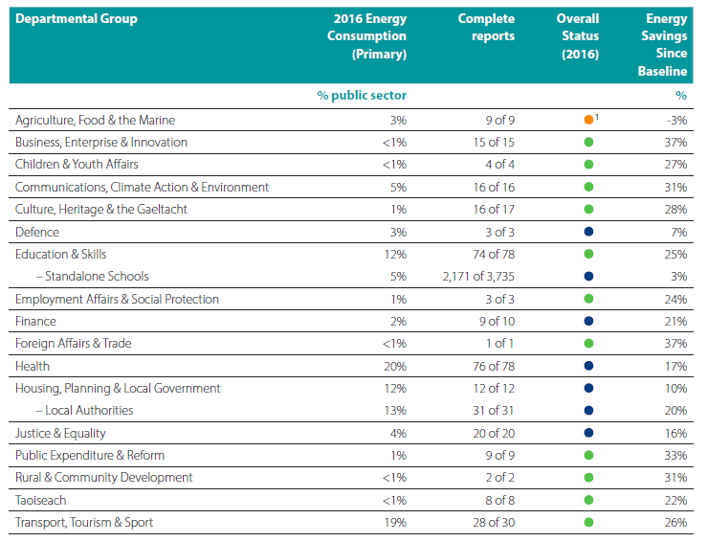
Government departments ‘accountability’
Notes:
8 departments shown here, including new Department of Rural & Community Development. The new department itself is not included in the 2 PBs shown because it was not in existence in 2016. But the PBs were, so they’re included here.

Slide 4
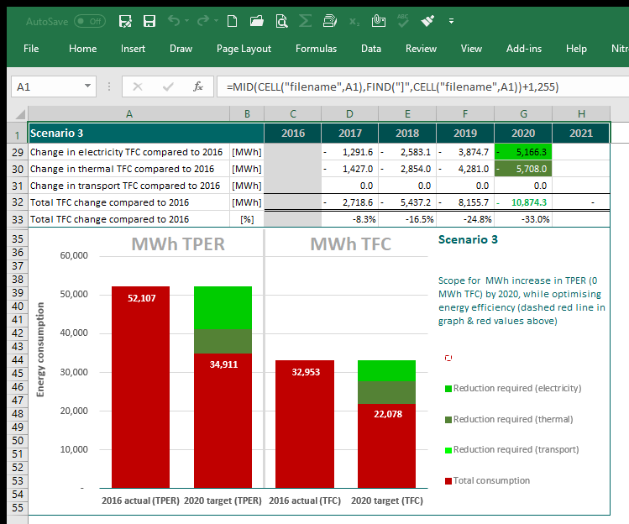
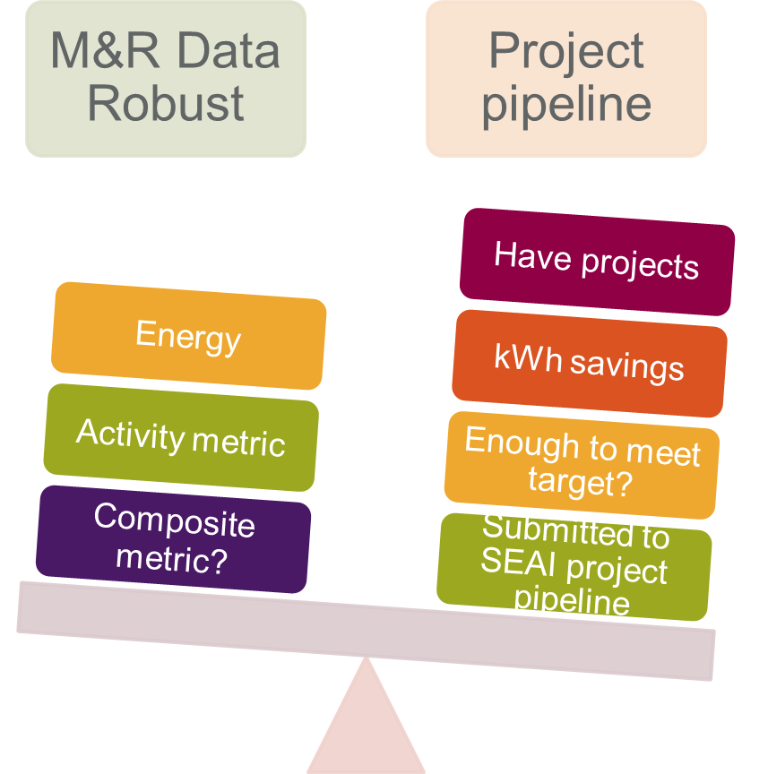
Organisational level Outputs
Gap to target analysis = project pipeline
Notes:
G2TT
We have set this up for all depts. and requested project outlines from each, BUT
little engagement on this to date as most departments unable to give enough detail
We help them with “back of the envelope” kWh calculations, but only when enough detail is available or forthcoming
DoES case study is perhaps best example as looks like the 3 lighting projects they have planned which seems to be enough to hit their own target. They also have further projects in their back pocket. See their presentation
Project Pipeline
If Fergus would like to provide latest update for 16 Govt Depts, we can check against what we know?
Has DoES submitted its lighting projects yet for example? Are Depts clear on how to do this (was a weblink promoted via DCCAE comms)?
https://pep.seai.ie/Account/Login.aspx?ReturnUrl=%2f

Slide 5

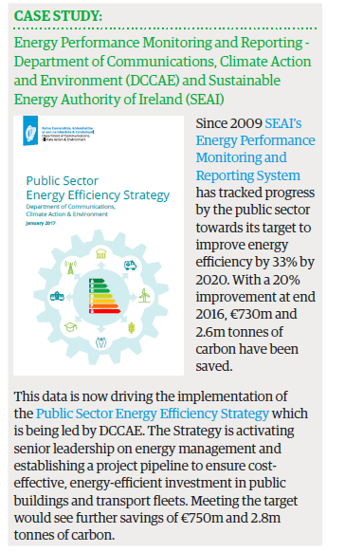
M&R – using the data – evidence based policy making

Slide 6
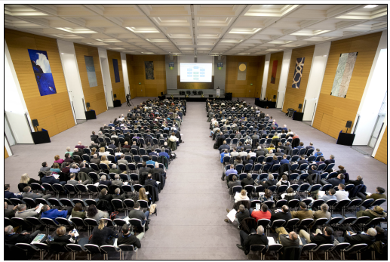







https://www.seai.ie/energy-in-business/public-sector/public-sector-energy-programme/
#33by2020
www.seai.ie

Slide 7
Future plans

Slide 8
Future plans
M&R strategy 2020 – 4 objectives
  Compliance
  Robustness of data for policy development
  Energy management & project pipeline
  Other reporting obligations i.e. DECs
Public facing data
  All data available to the public
‘Asset’ management
  What is an asset – building, water system, lights
  Performance

Slide 9







Overview
The context - Policy, legal & other drivers
M&R overview
M&R methodology
Outputs and Uses – policy, projects, & energy management
Future plans
Q&A

Slide 10
Thank you alan.ryan@seai.ie

Slide 11
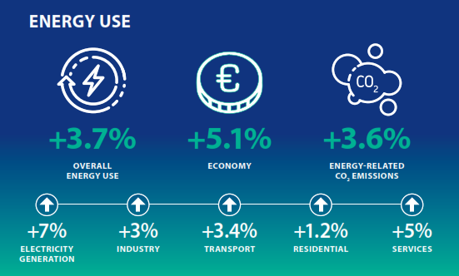
Energy in Ireland (2016)

Slide 12
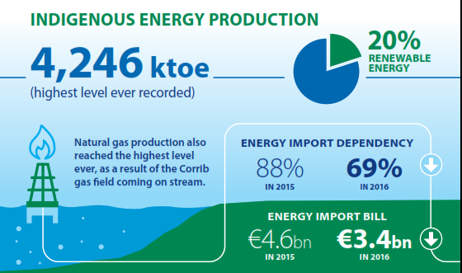
Local production

Slide 13
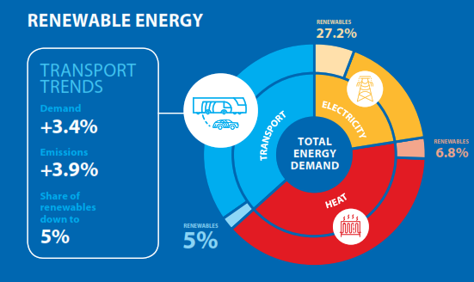
Transport & renewables

Slide 14
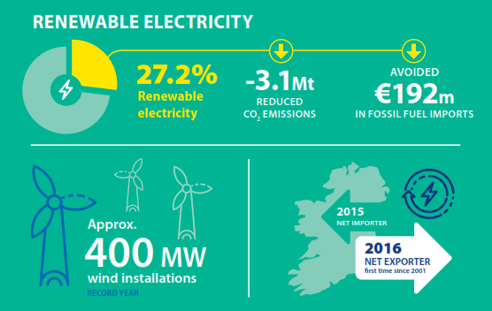
Electricity (contributes to your 33%)

Slide 15
