Slide 1


Study Visit
Conor Clarke CEng MIEI MCIBSE BSc(Eng)
Head of Energy Conservation Unit
Office of Public Works

Slide 2
Office of Public Works
Property Management (Central Government Portfolio) is one of the main activities of the Office of Public Works (OPW)
Approximately 2000 properties, many small,
Total Floor Space of 1M m² (for 50,000 Staff)
Predominantly office accommodation but also includes data centres, laboratories, heritage buildings, etc.
Total Energy Spend = €35M - €40M

Slide 3
Our Clients
OPW provides a central service in terms of technical expertise and management of buildings
Work closely with all our customers on a day to day basis.
OPW owns/leases the properties on behalf of the State
Individual occupying Departments pay for Energy

Slide 4
EU Energy Strategy 2020 - The 20:20:20 Targets:
Reduce Greenhouse Gas Levels by 20%
Increase share of Renewables to 20%
  Ireland Target = 16%
Improve Energy Efficiency by 20%
  33% Target in Public Sector!

Slide 5
The 2020 33% Public Sector Target
EU’s 2020 Climate & Energy Objectives set in 2009
National energy efficiency target 20%
Public Sector target of 33% improvement
Demonstrate leadership on energy efficiency for the whole of our economy and society.

Slide 6
The 2020 33% Public Sector Target
Public Sector Energy Efficiency Strategy (DCCAE) identifies very significant achievements to date
Identifies the need for a “step change in activity” to achieve 33% by 2020.
The Strategy document reports on the progress to date with savings of 21% (reported in 2016).

Slide 7
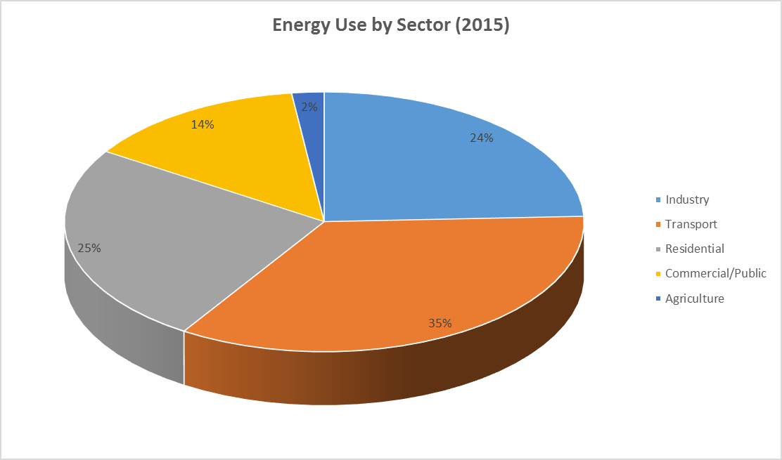
Who uses all the energy?

Slide 8
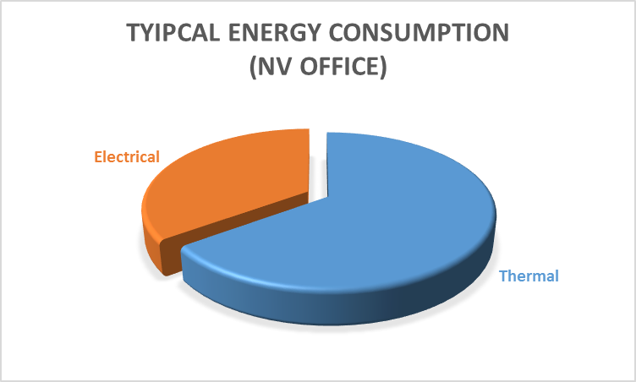
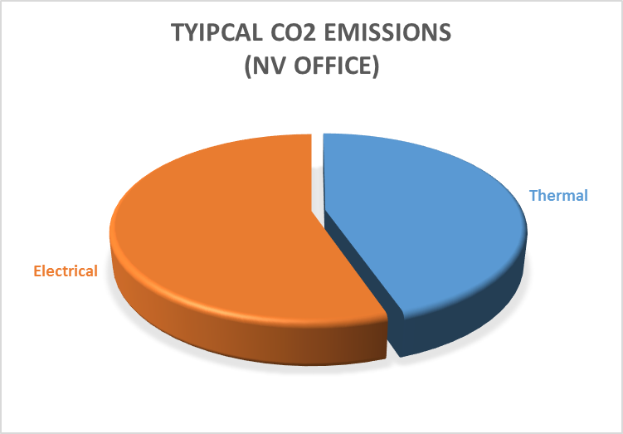
Energy and Emissions – Typical Office

Slide 9
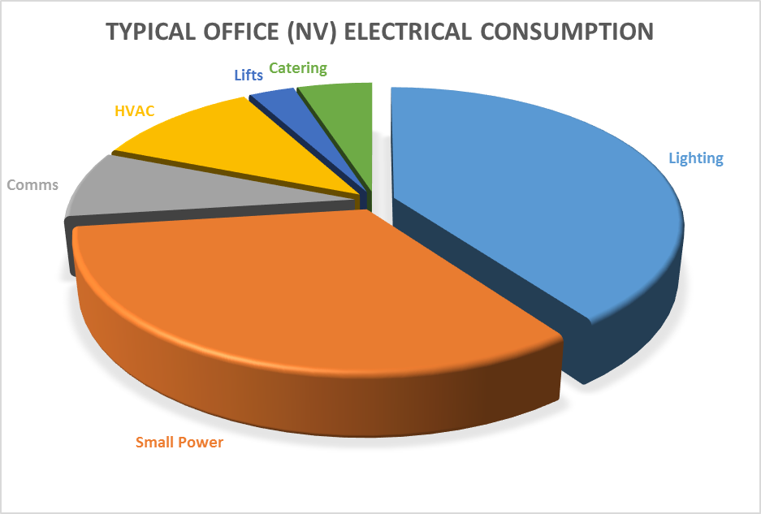
Energy and Emissions – Typical Office

Slide 10
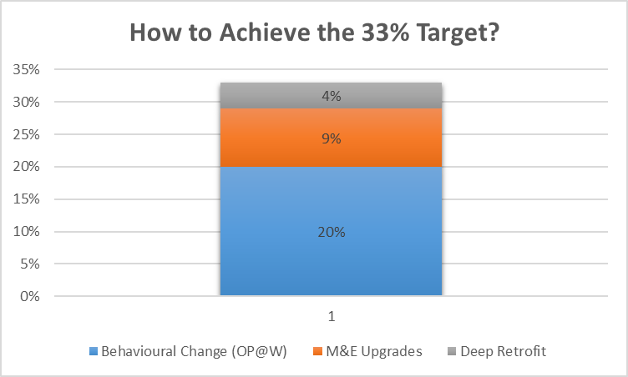
The OPW’s Strategy:

Slide 11
1) Optimising Power @ Work
(The First 20%)
Installed dedicated Energy Monitoring Systems in all Buildings (270 No.)
Ran pilot study in 10 buildings to see the scope for energy savings by behavioural change and low cost capital investment
After success of pilot studies launched large-scale programme.

Slide 12
Main Focus of the Pilot Study:
Switch Off
If it can’t be switched off now - Switch Off ASAP
Identify areas Of Energy Wastage

Slide 13
Concentrate on Electrical Consumption:
Electricity = 59% Total Energy Consumption
Electricity = 78% Carbon Dioxide Emissions
Staff have direct influence
Current Performance was ‘Poor’

Slide 14
Lessons from the Pilot:
35% Electrical Energy Used at Night
20% Electrical Energy Used at Weekends
55% Electricity used when building is unoccupied!

Slide 15
Unoccupied Buildings
Building 1
Building 2
Unoccupied
Occupied
Unoccupied
Occupied
55%
45%
54%
46%
Building 3
Unoccupied
Occupied
42%
58%
Building 4
Building 5
Unoccupied
Occupied
51%
49%
Unoccupied
Occupied
49%
51%

Slide 16
Optimising Power @ Work - Targets
Target 20% average annual energy saving.
Minimum saving of 15% in each building.
Buildings which have already achieved >20%: a 5% further reduction

Slide 17
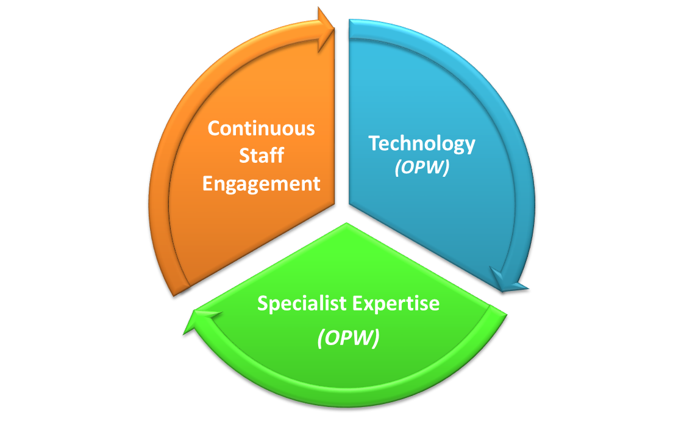
Programme Structure

Slide 18
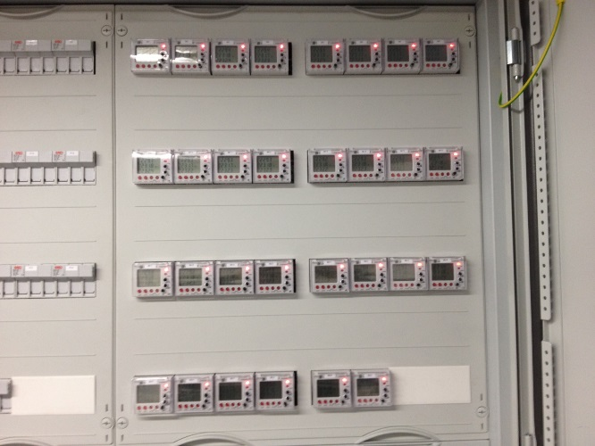
The key success factors:
  Three key elements to programme:
      Technology
      Specialist Expertise
      Continuous Staff Engagement
  Endorsement at Senior Management level
  Active energy teams within participating buildings cornerstone of the campaign

Slide 19
1. Technology :
Availability of up to date reliable energy data
  Install dedicated Energy Monitoring System
  Data collected (15 min) from multiple metering points
  Data transmitted to Central Energy Data Repository (CEDaR) Database
  Accessible over web
  Various Data Analysis/Analytics Packages available for Reporting and Analysis
  Over 300 buildings now in system

Slide 20
2. Specialist Expertise:
The application of adequate and suitable resources
  Potential net savings are up to three times the investment, per annum
  Worthwhile and necessary to apply proper and adequate resources
  A proper resource is an experienced specialist
  By applying suitable resources it is reasonable to set targets and expect results

Slide 21
3. Continuous Staff Engagement
Appoint Energy Officer
Establish Energy Teams
Campaign launch
Foster Staff Involvement
Set Targets and Benchmarks
Staff Presentations
Energy Team Meetings
Energy Workshops
Monthly Energy Reports / Targets

Slide 22


Available Resources:
Night time audits
BMS Audits
Monthly poster campaign
Display Energy Certs

Slide 23
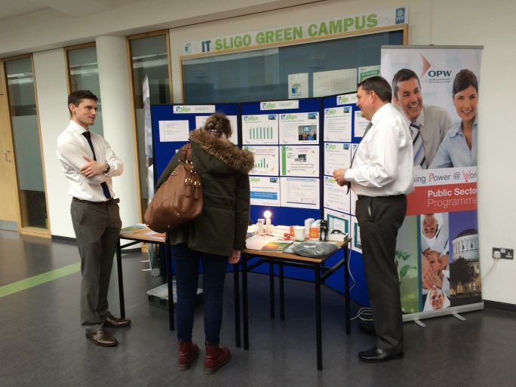
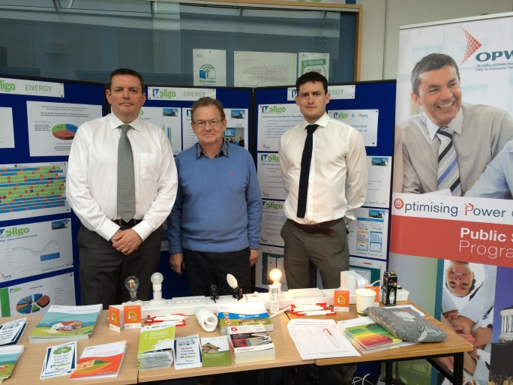
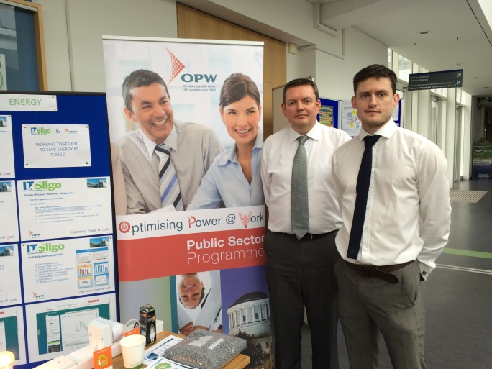
Awareness Days for Staff
University Hospital Galway
Leinster House
Energy Awareness Day
  Energy Use in Workplace & Home
  Lighting Displays
  Insulation (Wall, Attic & Water Tanks)
  Hand-outs / Temperature Cards / Guides
  Grant Information

Slide 24
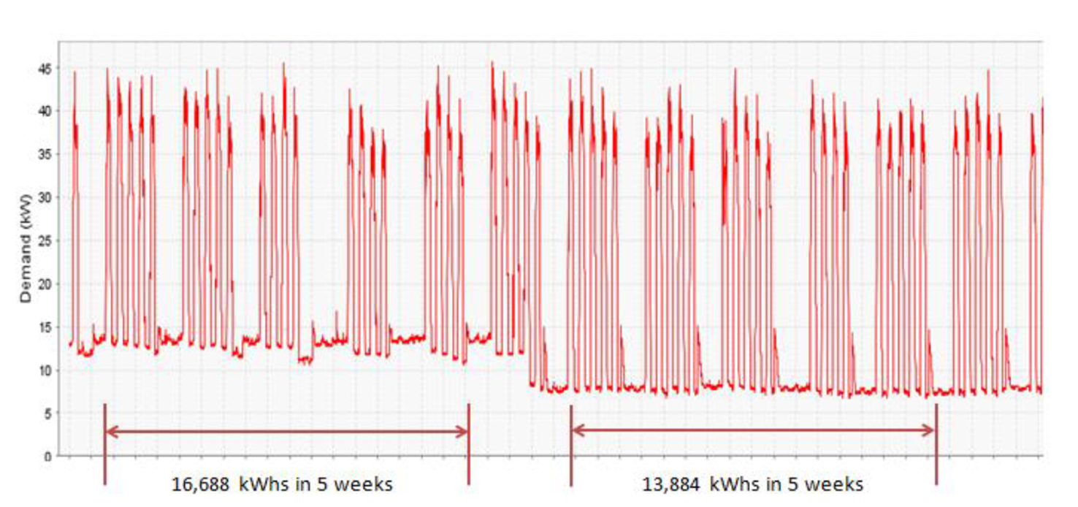
Automatic PC Power Down:

Slide 25
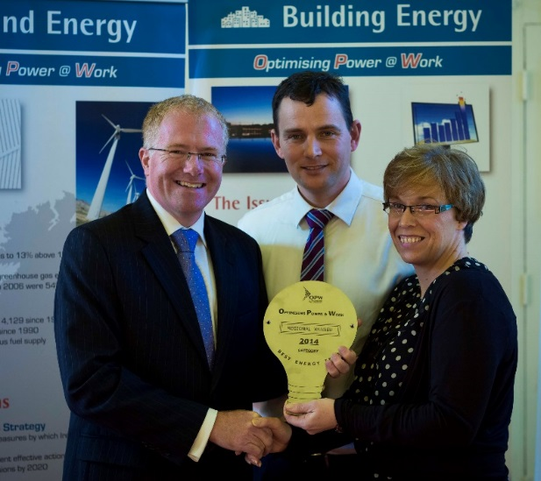
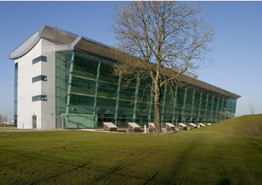
Staff Engagement – Annual Awards
Regional and National Awards Programme for best performing buildings.
Awards for different categories:
  Best Naturally Ventilated Building
  Best Air Conditioned Building
  Best Energy Team
  Outstanding Achievement
  Leinster Best Energy Team

Slide 26
Engagement = Savings
Level of Engagement
Excellent: Full support from management, appropriate and proactive Energy Officer and team, good response to the programme, taking their own initiative in energy savings.
Good: Good support from management, energy manager and team, medium/good response to the programme.
Fair: Reasonable support from energy manager and team, medium/fair response to the programme.

Slide 27
Levels of Engagement:

Slide 28
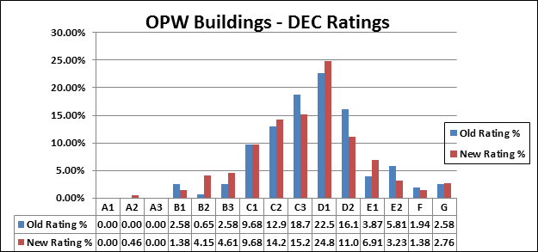
Display Energy Certs

Slide 29
Summary of Results (2017)
Particulars | Saving
Average Annual Energy Savings | 18.1%
Annual Cost Savings | >€6M/annum
Total Annual Energy Savings | 55.56 GWh

Slide 30
Public Sector Programme
Launched in 2014 with €9M funding from DCCAE
Same fundamental principles as Central Gov Programme but specifically tailored for different organisations
Open to all Public Sector Organisations meeting minimum energy usage criteria
Campaign is now underway in:
    15 Large Acute Care Hospitals
    9 Third Level Campuses
    15 Local Authority HQ Buildings
    9 Prisons
    Various HSE Estates buildings

Slide 31
Summary of Results – Public Sector Programme
Particulars | Saving
Overall Average Savings (2017) | 8.3%
Higher Education Campuses (5 No) | 11.6%
Acute Care Hospitals (5 No.) | 7.2%
Prisons (2 No.) | 5.1%
Local Authority Buildings (8 No.) | 6.3%
EPA Laboratories (5 No.) | 11.7%

Slide 32
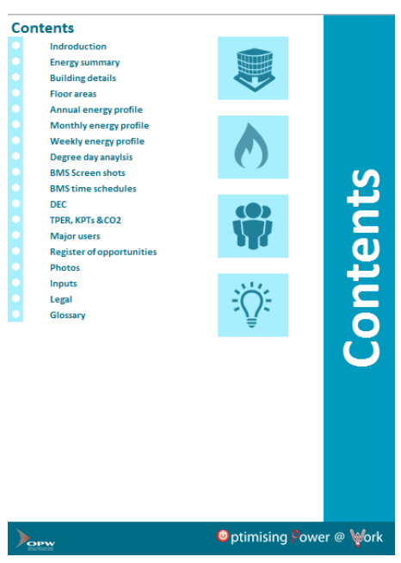
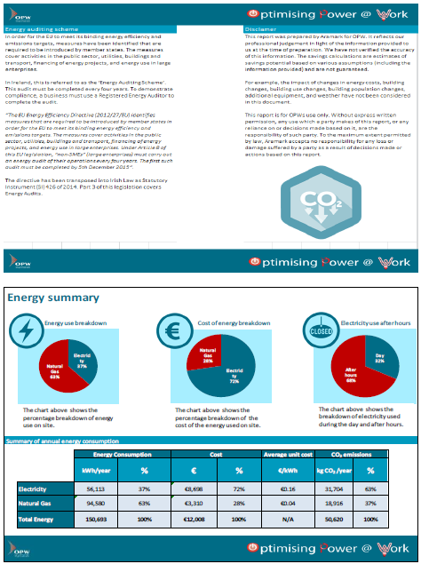
2) Energy Audits & Energy Retrofit Projects
(The Next 10%)

Slide 33
Energy Audits – Why are they required?
EU Energy Efficiency Directive identifies measures that are required to be introduced by member states in order for the EU to meet its energy efficiency and emissions targets
Transposed to Irish Law under SI 426/2014.
Energy Audits required for all public bodies with individual buildings with a total useful floor area of more than 500m2 or an annual energy spend of more than €35,000
All Central Government buildings participating in OP@W will have an Energy Audit carried out.

Slide 34
Energy Audit

Slide 35
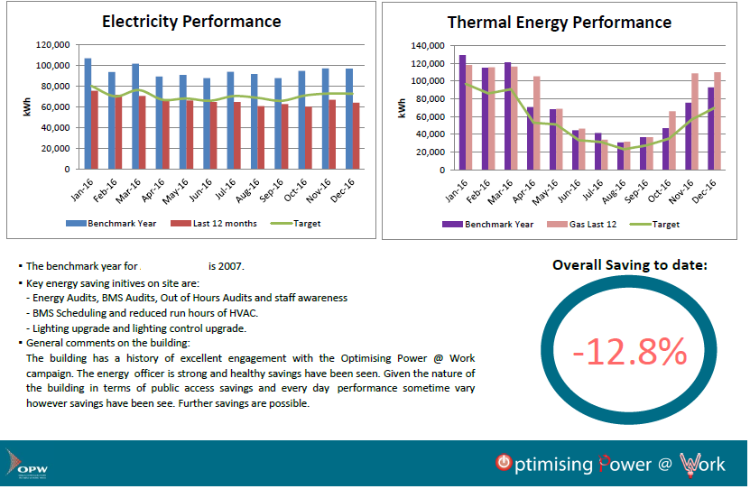
Energy Audit

Slide 36
Energy Usage Analysis
Site Energy Consumption & Spend
Energy Consumption Benchmarking
Electricity Usage Analysis
Thermal Usage Analysis

Slide 37
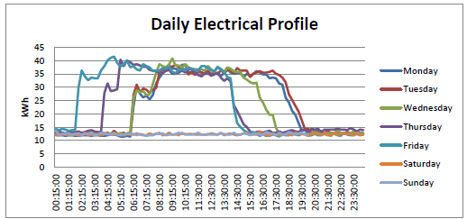
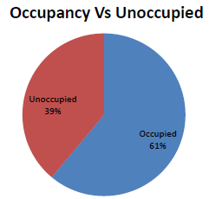
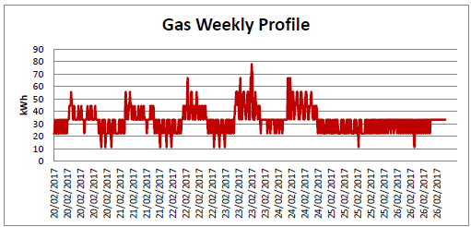

Slide 38
Energy Management Review
Staff Campaign
Building Management Systems
Boiler Analysis
Flue Gas Analysis
Pumps and Heating Distribution System
Heating, Ventilation & Air Conditioning
Domestic Hot Water
Chillers
Lighting
ICT & Comms Rooms
Catering and Tea Stations

Slide 39
Energy Management Review
Server Rooms and Comms
Office IT (PC’s, Copiers, Printers)
Building Fabric
Maintenance
Elevators

Slide 40
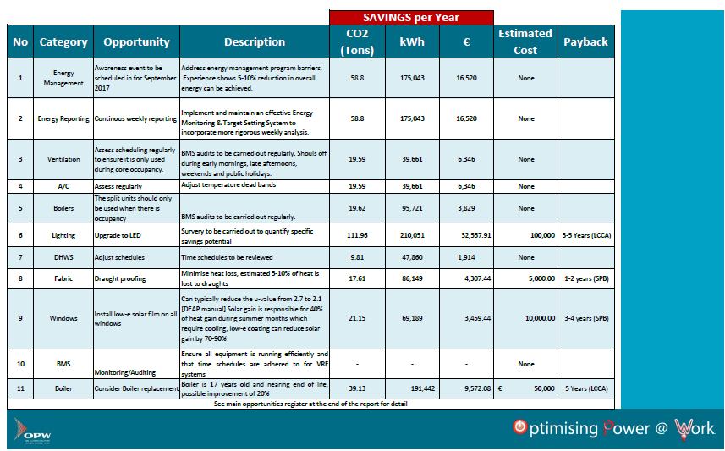
Energy Audit

Slide 41
Energy Retrofit Pilot Scheme
DCCAE has put in place a €4 million fund for upgrade projects to improve energy efficiency in Central Government properties
Joint venture between DCCAE, SEAI and OPW
Scalable model for energy retrofit investment in central government building stock.
Fund will inform the development of standard retrofit approaches that can be effectively and efficiently deployed throughout the entire public sector building stock from 2018.

Slide 42
Energy Retrofit Projects – Targeting the 9%
Lighting Systems and Controls
BMS Upgrades
Boiler Upgrades
CHP Projects – Where suitable

Slide 43
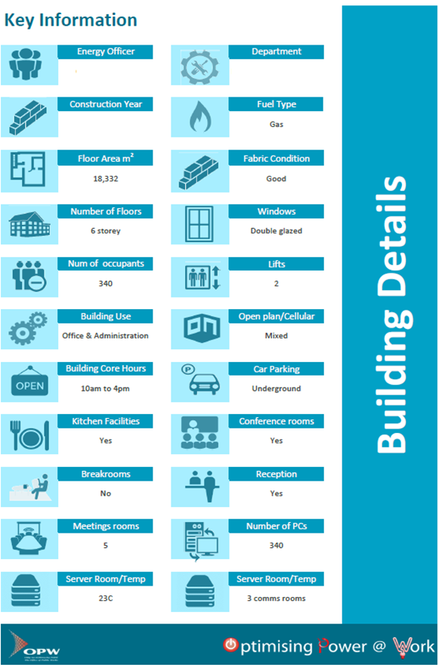
Selection Criteria for pilot:
Actively involved in OP@W
Have achieved >15% Savings
Suitable for Lighting/Boilers Upgrade
Data available
Prepared to accommodate works on site

Slide 44
OPW Research and Resources
LED rapidly advancing technology
Mock-up offices
  Lighting Manufacturers
  LED Characteristics
  Control Strategies (Absence, Presence, Daylight linking)
  Performance Specification
Procurement Frameworks
  Contractors
  Consultants
Sub Metering of Lighting Circuits

Slide 45
Process from conception to installation?
Full inventory of existing lighting system
Full survey of lighting levels in each area
Survey of existing control arrangements
Mock-up room with all new fittings
Installation of new fittings and controls
Commissioning of new system
(300 Lux to 500 Lux)

Slide 46
Speed Bumps along the way:
Emergency Lighting Systems
Poor condition of existing ceilings
Fire Alarm systems due for replacement
Low lighting levels in existing offices
Multi-occupancy Departments

Slide 47
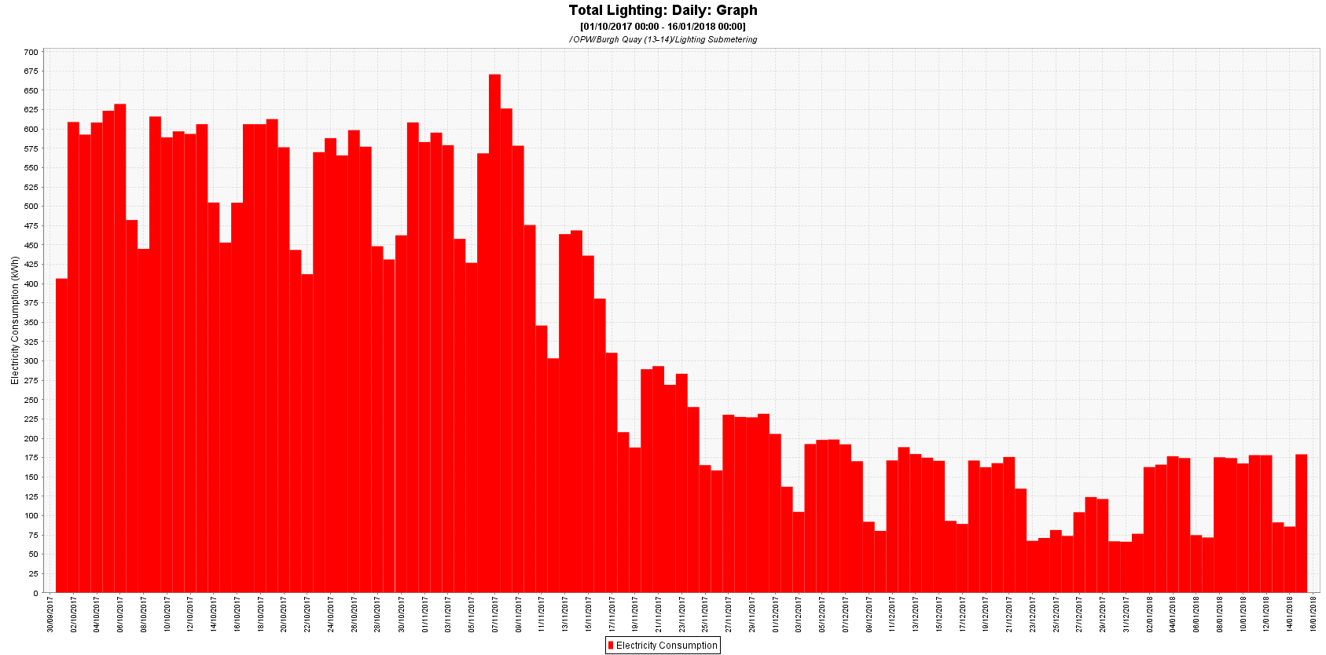
Building No. 1 – Lighting Load:
73% Reduction in Lighting
27% Reduction in Electricity
12% Reduction in Total Energy

Slide 48
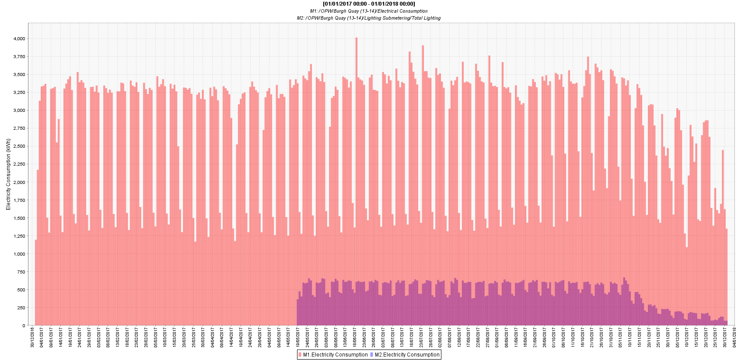
Building No. 1 – Total Annual Electrical Consumption

Slide 49
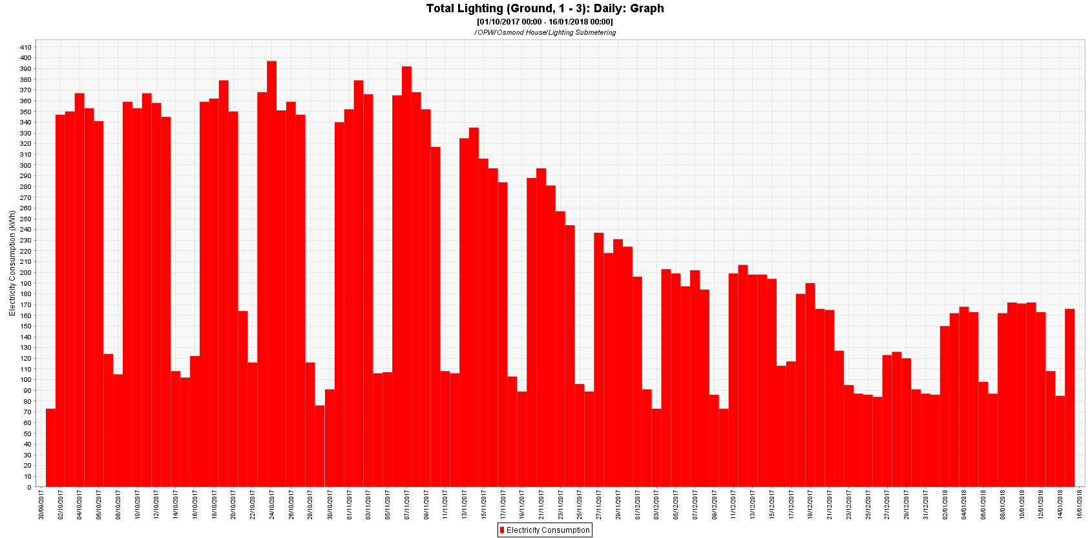
Building No. 2 – Lighting Load:
57% Reduction in Lighting
22% Reduction in Electricity

Slide 50
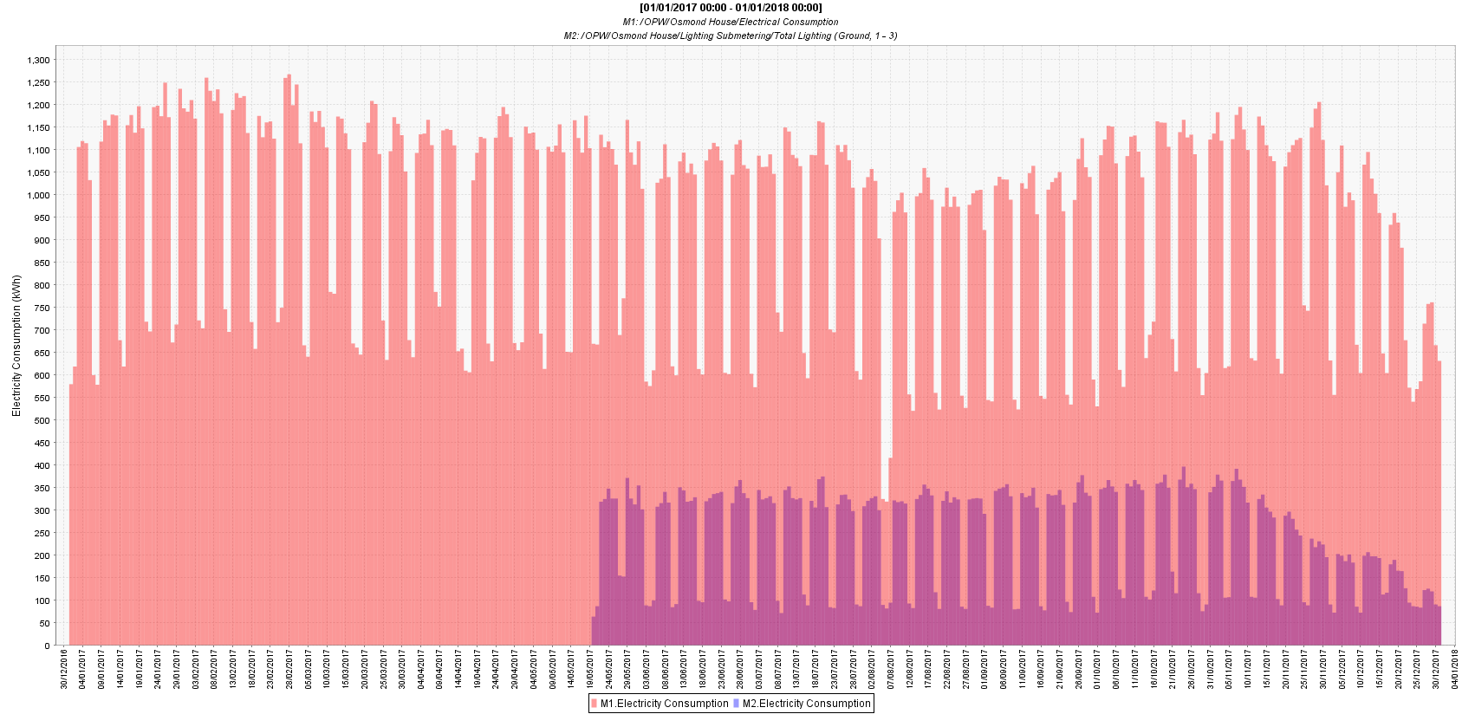
Building No. 2 – Total Annual Electrical Consumption

Slide 51
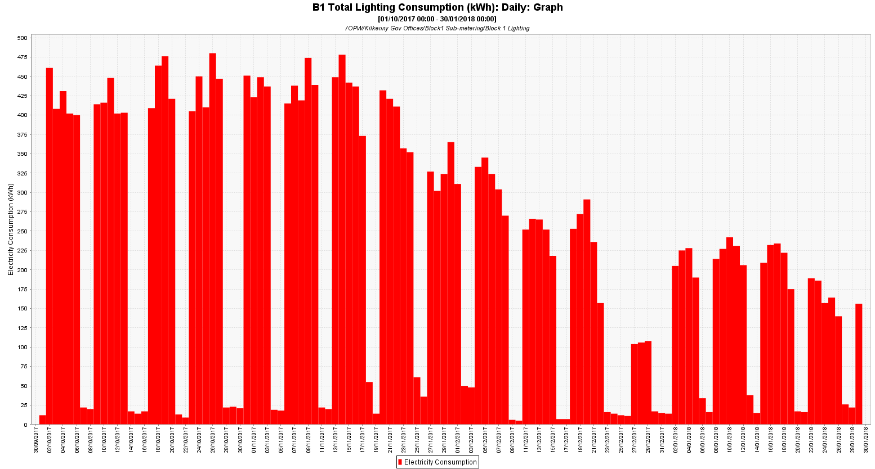
Building No. 3– Lighting Load:
64% Reduction in Lighting
33% Reduction in Electricity

Slide 52
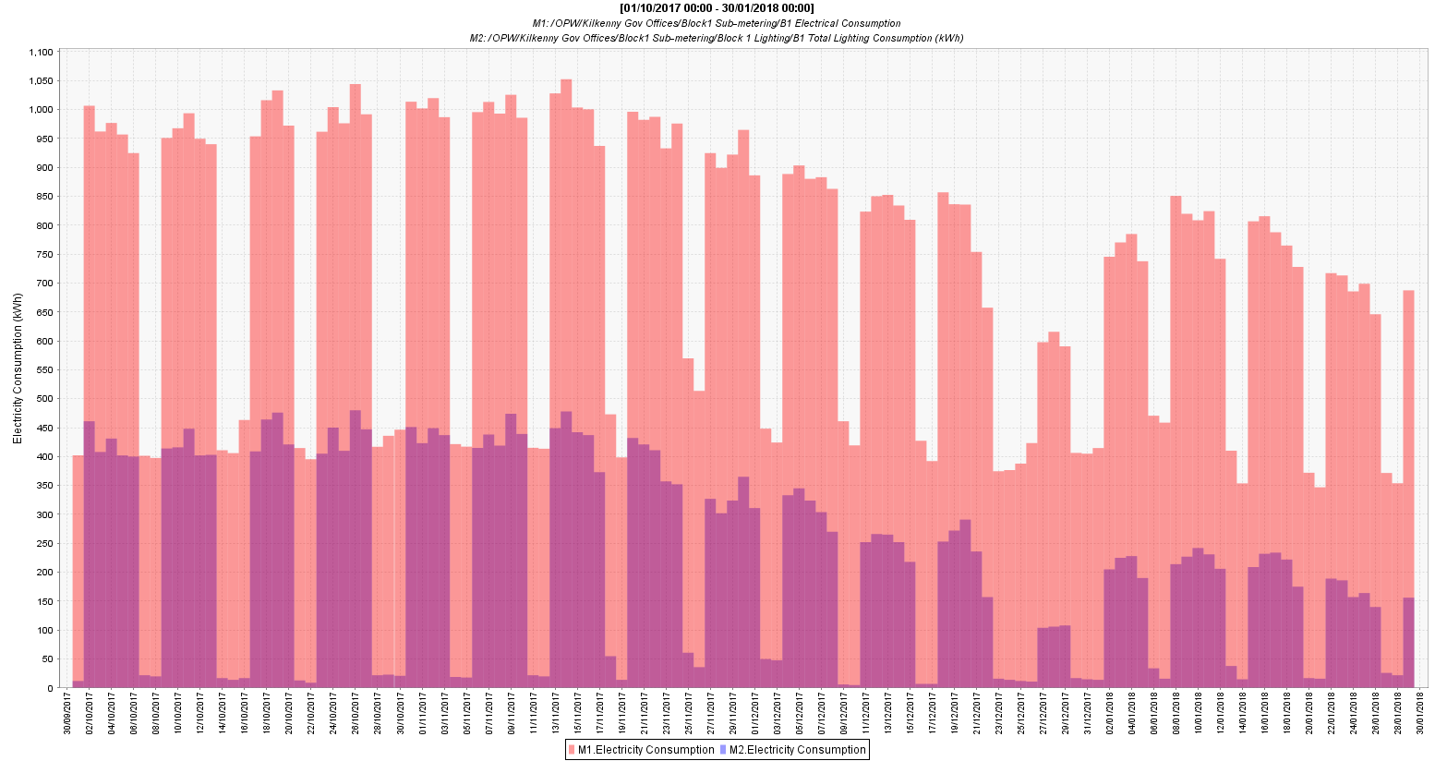
Building No. 3 – Total Electrical
56% Reduction in Lighting
21% Reduction in Electricity

Slide 53
Thank You

