Slide 1
MOBILISING FINANCIAL CENTRES
TOWARDS ENERGY EFFICIENCY FINANCING
STEPHEN NOLAN, CORK, FEBRUARY 2018

Slide 2
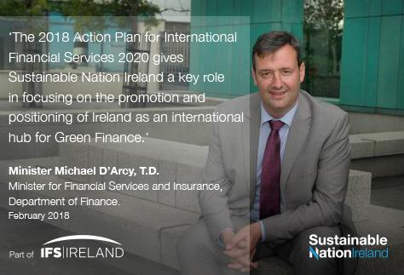

Slide 3
Green & Sustainable Finance Defined
Green and Sustainable Finance is:
Green Finance
Sustainable Finance
An emerging high growth International Financial Services sub-sector
Financial services that provide environmental benefits within the context of environmentally sustainable development, such as action on climate change
Financial services that are aligned with the Sustainable Development Goals, including the implementation of the Paris Agreement on Climate Change

Slide 4
Green & Sustainable Finance: The Context
Global policy drivers
UN Sustainable Development Goals
Paris agreement
The Financial Services Opportunity
Globally: $90 trillion to 2030 (G20 estimate)
In Ireland: €40 billion to 2050 (ISIF estimate)
On green finance specifically: UN, OECD, G20, G7, most recently the EU

Slide 5
HARNESSING FINANCIAL CENTRES
Financial centres add value through their cluster effect – how can this dynamic be harnessed for climate action and sustainable development?
A leadership group of financial centres is emerging – both market opportunities and policy imperatives combining to stimulate action.
An international network has now been launched – sharing experience and promoting common action – Ireland (Dublin & Cork) a founding member.
Real opportunities exist to deliver transformation – real economy connections, building capacity, cross-border flows, financial innovation.

Slide 6
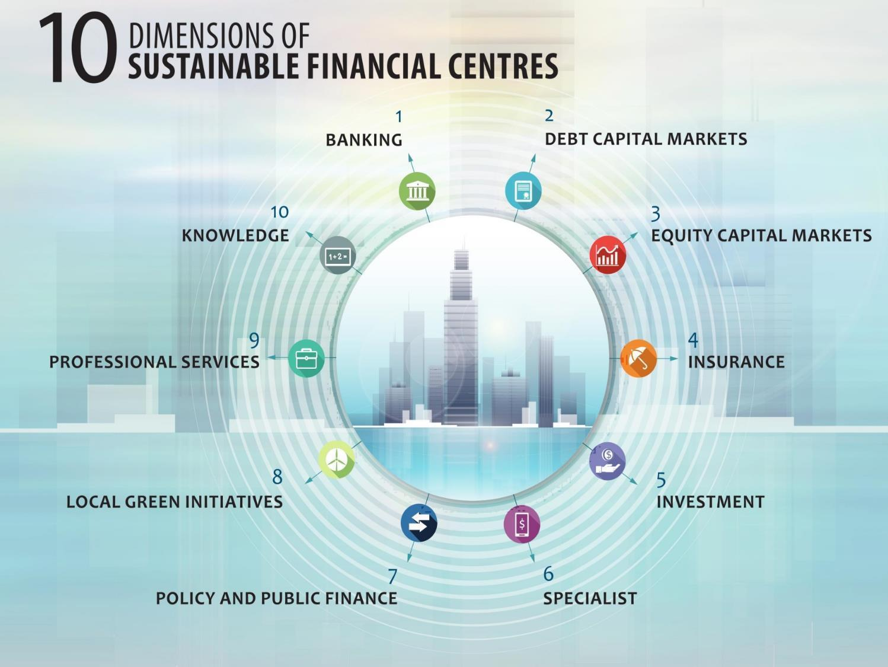

Slide 7
FINANCE: THE GROWING MOMENTUM
Agenda 2030 (SDGs):
Financing essential across infrastructure, innovation and inclusion
2015
COP 21 Paris Climate Agreement:
Making finance flows consistent with low GHG emissions and climate-resilient development
2015
2016
G20 China 2016
Green Finance Study Group:
Hangzhou G20 Heads of State pledge to scale up action; continued under Germany Presidency
FSB: Task Force (TCFD) report released for public consultation
2017
European Union: Sustainable Finance strategy, establishment of Expert Group
2017
2018
G7 Italy 2017:
Sustainable Finance – focus on Financial Centres & SMEs
European Union:
HLEG final

Slide 8
FINANCIAL CENTRES ARE MOBILIZING
Canada – Toronto
Green bond issuance, cleantech listings, provincial green funds
France – Paris
Paris Europlace. Finance for Tomorrow (2017)
Germany – Frankfurt
Deutsche Boerse. Accelerating Sustainable Finance Initiative (2017)
Italy – Milan
Italian National Dialogue (2016), Financial Centre Working Group (2017)
Action in G7 Countries
Japan – Tokyo
Global Finance City Initiative, Tokyo Green Bond planned
UK – London
City of London Corporation, Green Finance Initiative (2016)
USA – New York
State Green Bank, Wall Street – but no shared approach
Ireland:
SNI promoting Dublin as intl. green finance hub, under IFS 2020 Action Plan
Casablanca:
CFCA tasked to develop as an African green finance centre
Hong Kong: Commitments to advance green finance and fintech
RoW

Slide 9
EUROPEAN UNION

Slide 10
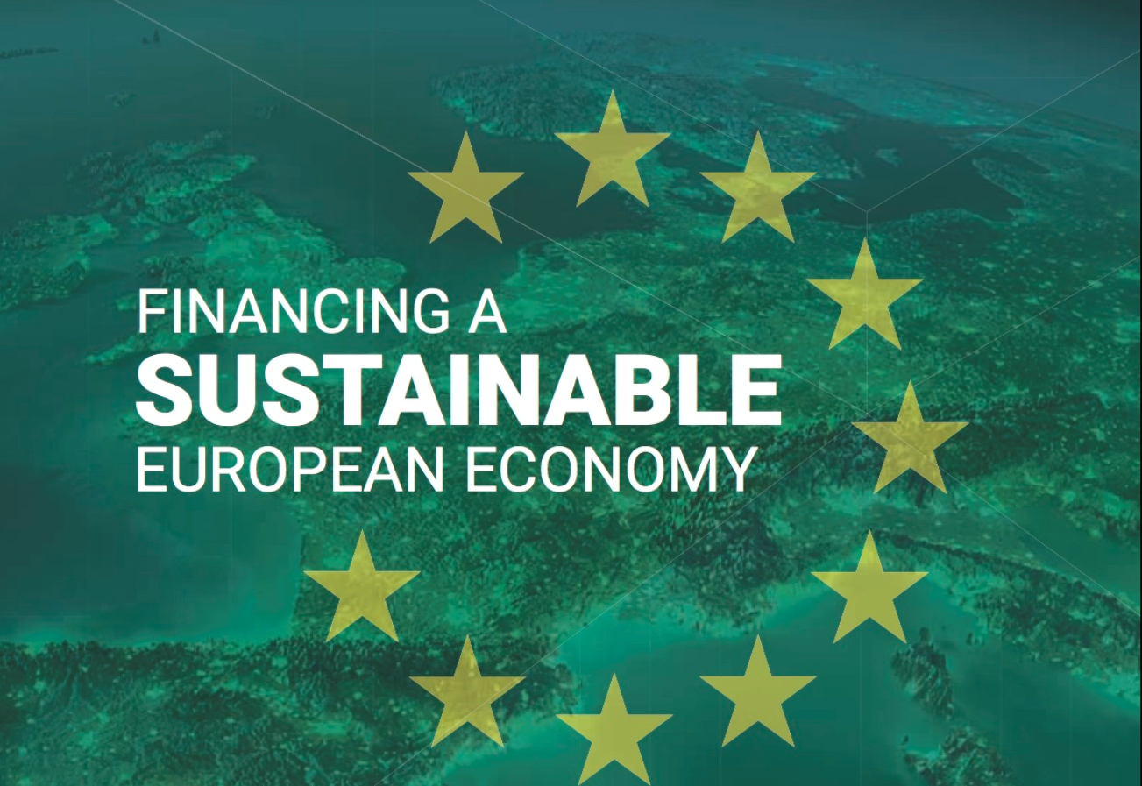
EU: HIGH-LEVEL EXPERT GROUP ON SUSTAINABLE FINANCE
“Nearly three-quarters of the EU’s 2030 clean energy investment gap is accounted for by energy efficiency buildings (circa €130 billion pa)… Now is the time for private financial institutions to enter the market at scale.”
Final EU HLEG on Sustainable Finance report, 31st January 2018

Slide 11
EU HLEG - FINANCING ENERGY EFFICIENCY
Delivering transformational improvements in energy efficiency is essential if Europe is to achieve its climate change / competitiveness goals
Nearly three-quarters of EU’s 2030 clean energy investment gap is accounted for by energy efficiency in buildings (circa €130BN) – historically financing EE was largely regarded as public finance exercise. Many of these programmes have created a market / useful instruments and approaches
Private financial instruments entering the market at scale – seeing investment opp., enhance value of underlying assets, portfolio performance and risk management
Financial regulators examining risk to real estate loans stemming from poor building standards – from 2023 on all Dutch office buildings must have an Energy Perf. Cert of C or else be taken out of use. Banks reviewing books
Constraints – include Eurostat interpretation of accountancy rules as they applied to EPCs in government accounts, for example recent Irish Exchequer squeeze meant limited govt. investment; lack of tagging by financial institutions, currently circa 20% of European bank loans are tagged with energy perf. info which is affecting ability to price loans/generate a pipeline (European Mortgage Federation solution)
Against this background EU HLEG recommends – Commission examine further how EE improve underlying asset value, helping to de-risk these type of investments; and consider the wider impact of energy savings for financial risk management allowing banks understand the environmental exposures in their balance sheets

Slide 12
IRELAND

Slide 13
Irish public sector
Constraints – Eurostat interpretation of accountancy rules; recent Irish Exchequer squeeze; lack of tagging by financial institutions, however all being tackled
Public sector - a lot of heavy lifting by government agency SEAI (pilot programmes, data capture, significant grants to commercial / domestic, driving public service goals, engaging with banks on data / new products); plus creation by government of the €75 million Irish Energy Efficiency Fund. Results include:
In 2016, public sector improved its energy efficiency by 20% equating to €133 million in avoided energy spend as well as 520,000 fewer tonnes of CO2 emissions in 2016 alone
Since 2009, cumulative avoided energy spend is €737 million with 2.68 million tonnes of emissions avoided
Foundations now set to allow significant ramping up of future EE financing efforts, in the main led by commercial financial institutions

Slide 14
Irish commercial sector examples
ESB SMART ENERGY SERVICES
Working with 300 Irish and UK based businesses
Saving €150 million on energy bills between now and 2020
Examples include Tesco, Dublin airport, Cork airport and Coral leisure swimming pool
SANTRY SPORTS CLINIC, DUBLIN
Urban Volt project
Number of LED fittings: 1,338
MWH saved annually: 424
Net annual saving: €34,000
% cash saving: 63%
Capital investment by the client: €0
Time investment by the client: Zero

Slide 15
To close…
Heavy lifting – great deal done by government agencies, i.e. data, pilots, grants, advocacy, etc
EU HLEG final report – a game changer, recognizes size of EE investment gap, makes recommendations to further mobilise private sector capital
Commercial financial institutions – recognizing opportunity and risks on their own balance sheet. Now moving quickly to deal with, developing new products, credit risk understanding, etc
Lot more to do, but moving in the right direction …

Slide 16
Thank you!

